Slide 1


Certified Software Test Engineer (CSTE)
Software Testing Principles and Concepts
Sunday, November 8, 2026

Slide 2

Agenda – Part1
Vocabulary
Why Do We Test Software?
Multiple roles of the Software Tester

Slide 3
Vocabulary
Knowledge of a profession and the ability to convey the knowledge unique to a profession to others
Quality Assurance versus Quality Control
Cost of Quality
Software Quality Factors
Quality Defined

Slide 4
Quality
Working definitions:
  Producer’s view – Quality of product meets requirements
  Customer’s view – Quality of product “fit for use”/ meets customer’s needs

Slide 5
Quality Assurance vs. Quality Control
Preventive methods | Detective methods
Planned, systematic activities necessary to provide adequate confidence that products and services will conform to specified requirements and meet user needs | Process where product quality compared to applicable standards with action taken upon detection of nonconformance.
Staff function, responsible for implementing the quality policy defined through the development and continuous improvement of software development process | Line function where work is done within a process to ensure that the work product conforms to standards and requirements
Activities that establish and evaluate the processes that produce products | Activities that focus on identifying defects in the actual products produced.
Measures processes to identify weaknesses, then correct these weaknesses to continually improve the Process | Activities begin at the start of the software development process wit reviews of requirements, and continue until all application testing is complete
Relates to all products or services that will ever be created by a process | Relates to specific product or service
Helps establish processes and measurement programs to evaluate processes | Verifies whether specific attributes are or are not in a specific product or service
Identifies weaknesses in processes and improves them | Identifies defects for the primary purpose of correcting defects
Responsibility of management | Responsibility of team/worker

Slide 6
Quality Assurance vs. Quality Control (cont.)
QA = QC over QC because it evaluates whether QC is working
QA staff don’t do QC except to validate that the QC process is working

Slide 7
The Cost of Quality
All costs above producing the product right the first time.
Quantifies total cost of prevention, appraisal & production of software
Includes costs of assuring delivered product meets established quality goals
Includes costs of preventing, identifying & correcting defects

Slide 8
The Cost of Quality (cont.)
Prevention Costs
  Establishing methods & procedures
  Training
  Tool acquisition
  Quality planning
  Costs incurred prior to build
Appraisal Costs
  Comparing completed product to requirements
  Inspections
  Testing
  Reviews
  Costs incurred after build but prior to ship or moved to production

Slide 9
The Cost of Quality (cont.)
Failure Costs
  Costs associated with delivering a defective product to user or
  deploying to production
  Repairing products to meet requirements
  Cost of operating faulty product
  Damage caused by faulty product
  Help desk operations

Slide 10
The Cost of Quality (cont.)
Identification and correction of defects account for a majority of the Cost of Quality
Production costs can be minimized by focusing on preventing defects
Eliminate rework and build inspection into the process to attain the goal of optimizing the production process
Continuous testing applied to the development process can reduce the cost of quality
The IT QA group is responsible for identifying, quantifying and developing programs that minimize prevention, appraisal & failure costs

Slide 11
Software Quality Factors
Correctness
Reliability
Efficiency
Integrity
Usability
Maintainability
Testability
Flexibility
Portability
Reusability
Interoperability

Slide 12
How Quality is Defined
Based on customer satisfaction
Must be defined before it can be realized
Corporate sponsorship a must
5 perspectives of quality
  Transcendent – I know when I see it
  Product-based – Desired features included
  User-based – Fit for use
  Development/manufacturing-based – Conforms
  to requirements Value-based – Cost is acceptable

Slide 13
How Quality is Defined (cont.)
Quality in Fact | Quality in Perception
Doing the right thing | Delivering the right product
Doing it the right way | Satisfying our customer’s needs
Doing it right the first time | Meeting the customer’s expectations
Doing it on time | Treating every customer with integrity, courtesy and Respect

Slide 14
Why Do We Test Software?
Concepts that explain why we test software
  Developers are not Good Testers
  What is a Defect?
  What is Quality Software?
  Why Does a Development Process Produce Defects?
  Reducing the Frequency of Defects in Software Development
  An effective development process that minimizes defects
  How is quality defined?

Slide 15
What is a Defect ?
A defect is an undesirable state
Must define desirable state before comprehending an undesirable state
Quality = desired state
To understand a defect we must understand quality

Slide 16
What is Quality Software?
IT’s view: Requirements Met
Customer’s view: Fit for use
Two software quality gaps
  User’s view of quality
  ^
  User gap
  v
  Producer’s view of quality as specified
  ^
  IT gap
  v
  IT’s view of quality as delivered

Slide 17
Sources of Variation
Measurement components
  Counting
  Sampling
Material components
  Forms
  Suppliers
Machine components
  Office equipment
  Computers
  Software
Method components
  Procedures
  Policies
  Accounting practices
People components
  Training
  Experience
  Attitude
  Aptitude
Environment components
  Temperature
  Humidity
  Noise level
  Lighting

Slide 18
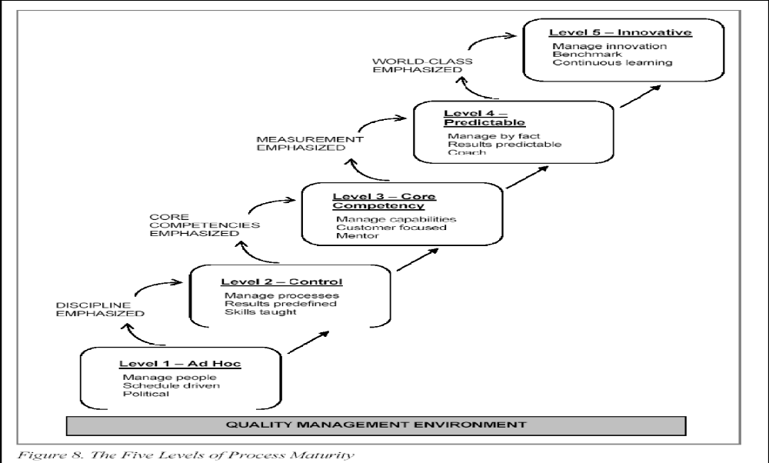
Five Levels of Process Maturity in a Quality Management Environment

Slide 19
Multiple Roles of the Software Tester
People Relationships
Scope of Testing
When Should Testing Occur?
How the Test Plan Should be Developed
Testing Constraints

Slide 20
Agenda – Part 2
Life Cycle Testing
Test Matrices
Independent Testing
Tester’s Workbench
Levels of Testing
Testing Techniques

Slide 21
Life Cycle Testing
Involves continuous testing throughout the SDLC
Testing should occur at several point to identify defects as early as possible
Requires a formally developed process
Requires IT to determine a strict schedule in which completed pieces of the system are delivered
Best accomplished by forming a test team
Team must use structured methodologies, different than those used by the development team
Both teams begin work at the same time with same info
Dev team defines and documents reqs for implementation purposes
Test team uses the reqs to test the system
At appropriate points in the dev process, test team runs compliance process to uncover defects
Testing continues after deployment… until system replaced or updated

Slide 22
Test Matrices
…Show functional event and test interrelationships
…Define conditions that must be tested to verify the system functions properly
…Don’t represent all testing, some tests that verify structure aren’t included
Left side shows functional events, top lists the tests to be performed on the events
During the requirements phase, the process may be vague and generalized but will take shape as the life cycle progresses, eventually expanded to the point where test transactions can be prepared from the info in the matrix

Slide 23
Independent Testing
Tester’s responsibility is to ensure that quality is measured accurately
Loosest definition of independence: org. has a tester or staff dedicated to testing
Tester roles and reporting structures vary between and within organizations. Ideally, test resources will have a reporting structure independent for the design and/or development group

Slide 24
Independent Testing (cont.)
Tester skill set misconceptions:
  Testing is easy
  Anyone can test
  Training & experience not necessary
Effective testers:
  Understand the system
  Understand the technology on which the system is to be deployed
  Possess creativity, insight & business acumen
  Understand the development methodology and resulting deliverables/artifacts

Slide 25
Tester’s Workbench
A testers workbench is a pictorial representation of how a specific test task is performed
A process is a set of activities that depict how work is performed
Two ways to visually portray a process
  PDCA cycle
    Conceptual view of a process
  Workbench
    Practical illustration

Slide 26
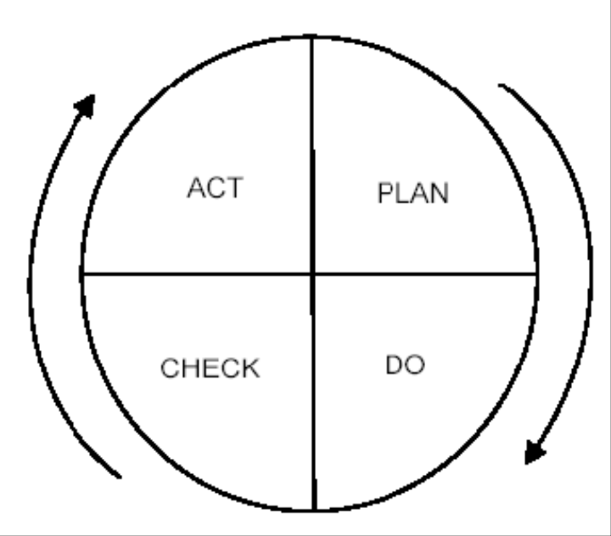
PDCA Cycle
P – Devise a Plan
D – Do the plan
C – Check the results
A – Act (take any necessary actions)

Slide 27
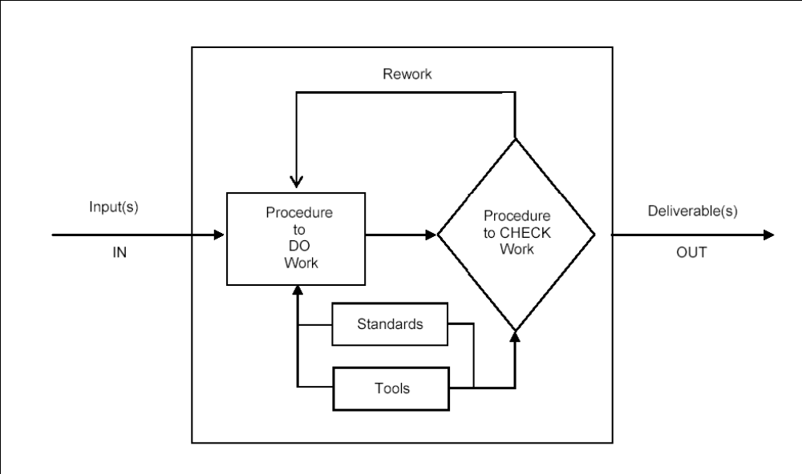
Workbench Visual

Slide 28
Levels of Testing
The sequence in which testing occurs is represented by different levels or types of testing:
  Verification testing – Static testing of development products
  Unit testing – Verifies the system functions properly
  Integration testing – System runs tasks involving multiple applications or databases
  System testing – Simulates operation of entire system verifying that it ran correctly
  User acceptance testing – Real-world test that means the most to your business, impossible to conduct in isolation, once customers begin interacting with the system they’ll verify that it works

Slide 29
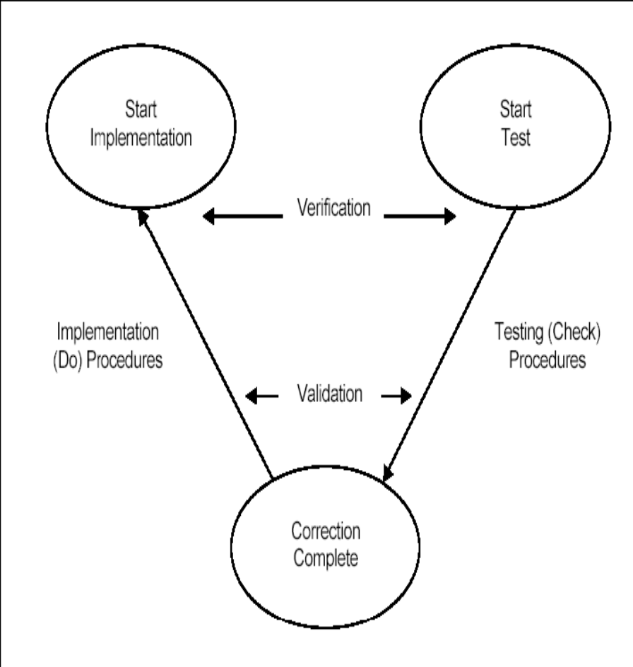
The “V” Concept of Testing
Visual representation of life cycle testing
11-step software testing process pp. 94
“V” represents both the software development and testing processes
The first 5 steps use verification to evaluate correctness of interim deliverables
Validation is use to test the software in executable mode
Results of both verification and validation documented
Both used to test installation and changes to the software
Final step of the “V” process represents both the development and test team evaluating the effectiveness of testing

Slide 30
11-Step Software Testing Process
1. Assess development plan and status
2. Develop the test plan
3. Test software requirements
4. Test software design
5. Program (build) phase testing
6. Execute and record results
7. Acceptance test
8. Report test results
9. Software installation
10. Test software changes
11. Evaluate test effectiveness

Slide 31
Testing Techniques
Structural vs. Functional Technique Categories
Verification vs. Validation
Static vs. Dynamic Testing
Examples of Specific Testing Techniques
Combining Specific Testing Techniques

Slide 32
Structural vs. Functional Technique Categories
Structural | Functional
Referred to as “White Box” testing because knowledge of the internal logic of the system is used to develop hypothetical test cases | Called “Black Box” testing because no knowledge of the internal logic of the system is used to develop test cases
Uses verification techniques | Uses validation techniques
Advantage – Allows for testing structures logic | Advantage – Simulates actual system usage
Advantage – Covers code not covered by functional testing | Advantage – Makes no system structure assumptions
Disadvantage – Doesn’t ensure users requirements met | Disadvantage – Potential of missing logical errors
Disadvantage – Tests may not mimic real-world situations | Disadvantage – Possibility of redundant testing
Both methods together validate the entire system.

Slide 33
Verification vs. Validation
Verification examples | Validation examples
Requirements reviews | Unit testing
Design reviews | Integrated testing
Code walkthroughs | System testing
Code inspections | User acceptance testing

Slide 34
Static vs. Dynamic
Static testing is performed using the documentation, no code is executed
Dynamic testing requires the code to be in an executable state to perform the tests
Most verification techniques are static tests
  Feasibility reviews
  Requirements reviews
Most validation techniques are dynamic
  Unit testing
  Integrated testing
  System testing
  User acceptance testing

Slide 35
Specific Testing Techniques
White-box testing
Black-box testing
Incremental testing
Thread testing
Requirements testing
Desk checking and peer review
Walkthroughs, inspections and reviews
Proof of correctness techniques
Simulation
Boundary value analysis
Error guessing and special value analysis
Cause-effect graphing
Design-based functional testing
Coverage-based testing
Complexity-based testing
Statistical analyses and error seeding
Mutation analysis
Flow analysis
Symbolic execution

Slide 36
Combining Specific Testing Techniques
Using multiple tests in concert can form more powerful and efficient testing techniques
  Merger of standard testing techniques with formal verification. Certain modules where security and reliability justify the added expense of formal verification
  Combining symbolic execution and coverage analysis to cover most often executed segments
  Formal proof techniques can help determine equivalent mutants… a problem area with mutation analysis

Slide 37
        Q & A

Slide 38
THANK YOU

